Slide 1
FrameNet
The work. The product.
The applications.
CJFillmore - ICSI/Berkeley

Slide 2
Acknowledgements
International Computer Science Institute
National Science Foundation
Defense Advanced Research Projects Agency

Slide 3
Frames and Understanding
Hypothesis: People understand things by performing mental operations on what they already know. Such knowledge is describable in terms of information packets called frames.

Slide 4
The core work of FrameNet
characterize frames
find words that fit the frames
develop descriptive terminology
extract sample sentences
annotate selected examples
derive "valence" descriptions

Slide 5



D I G R E S S I O N
Actually there are two contexts in which you will probably be asked to do FrameNet annotations.
  One is for purely lexicographic purposes, where you will choose “good examples” of the use of each word.
  The other is for full text analysis, where you will analyze every word in a text.
The description that follows concentrates on the lexicographic work

Slide 6
The core work of FrameNet
characterize frames
find words that fit the frames
develop descriptive terminology
extract sample sentences
annotate selected examples
derive "valence" descriptions

Slide 7
Finding words that belong in a given frame
We look for words in the language that bring to mind the individual frames.
We say that the words evoke the frames.

Slide 8
“Words”?
But first there’s an enemy we have to deal with: polysemy, lexical ambiguity, multiple meanings of a single “word”.
Instead of words, we have to work with lexical units (LUs), each of these being a pairing of a word with a sense.

Slide 9
FrameNet is at the “splitting” end of the “splitting” versus “lumping” continuum when it comes to the monosemy/polysemy.
What could count as evidence for the separateness of lexical units with the same form?

Slide 10
Discernible meaning differences.
If a word communicates different meanings in different contexts, and the difference isn’t explained by the contexts, maybe the word has more than one meaning.
She earns a lot less than she deserves.
I made a lot of money, but I earned it.
The second sentence conveys the idea that the amount of money earned was appropriate.

Slide 11
How many meanings for replace?
put (sth) back where it belongs
occupy a position formerly occupied by (sth,sbd)
put something in a position formerly occupied by (sth,sbd)

Slide 12
John replaced me.

Slide 13
John replaced the telephone.

Slide 14
Just having different argument types in grammatical positions isn’t enough.
Subject as Speaker:
Mom explained …, you complained …, she said …, I insist …, the dean informed us …
Subject as Medium:
chapter 2 explains …, your letter complains …, the Bible says …, the law insists …, the editorial informed …

Slide 15
Those don’t require separate senses.
The “Medium-as-Subject” examples can be thought of as Metonymy. Thus:
Chapter 2 explains … =
The author explains in Chapter 2 that …
Your letter complains that … =
You complain in your letter that …

Slide 16
Speaker as Subject
Medium as Subject

Slide 17
Here’s a different situation:
Some - but not all - “verbs of speaking” have a “cognitive” use, identifying sources of beliefs or belief-attitudes, with no communicating implied.
The heavy winds explain the number of windmills around here. (*explicate)
These facts argue in favor of your hypothesis. (*reason)(*quarrel)
His repeated absence at meetings suggests that he’s not happy with the job. (*hints)

Slide 18
Speaker as Subject
Medium as Subject
Fact as Subject

Slide 19
That is, we take the fact that some but not all words in a particular semantic class have special meaning elaborations “argues for” a polysemy interpretation in those cases.

Slide 20
Different Complementation
Complementation patterns should go with particular meanings of a word.
Medical sense of complain:
the patient complained [of back pains]
Official act sense of complain:
we complained [to the manager] [about X]
she complained [that her checks were late]

Slide 21
Argument omissibility
We would argue that the ordinary sense of give and the ‘contribute’ sense of give should be separated, since they differ in argument omissibility:
  Do you want to meet the Red Cross representative? - I already gave.
  Did you remember a present for your daughter’s birthday?
  - *I already gave.

Slide 22
If a verb has two different event noun derivatives, and they have different meanings that are also found in the verb, that verb should be described as polysemous.

Slide 23
Nominalization Differences
adhere to a belief: adherence
adhere to your skin: adhesion
observe a rule: observance
observe the kids: observation
commit to a cause: commitment
commit to an asylum: commitment
commit a crime: commission
deliver a package: delivery
deliver sb. from danger: deliverance

Slide 24
Support verb differences with nominalizations
argue: quarrel sense associated with have an argument; reasoning sense with make an argument
commit: dedication sense associated with make a commitment; crime/sin sense & incarceration sense, no support verb
complain: symptom report: present a complaint; kvetch: no support verb; official: file a complaint, register a complaint

Slide 25
Lexical Field Membership
complain in medical context links with presént, symptoms, ailments, etc.
complain in official context links with charge, grievance, etc.
complain in informal context links with bitch, kvetch, gripe, whine, etc.

Slide 26
FN work: characterizing frames
Let’s work through the Revenge frame.

Slide 27
The Revenge frame
The Revenge concept involves a situation in which
A has done something to harm B and
B takes action to harm A in turn
B's action is carried out independently of any legal or other institutional setting

Slide 28
Vocabulary for Revenge
Nouns: revenge, vengeance, reprisal, retaliation
Verbs: avenge, revenge, retaliate (against),
get back (at), get even (with), pay back
Adjectives: vengeful, vindictive

Slide 29
FN work: choosing FE names
We develop a descriptive vocabulary for the components of each frame, called frame elements (FEs).
We use FE names in labeling the constituents of sentences exhibiting the frame.

Slide 30
FEs for Revenge
Frame Definition: Because of some injury to something-or-someone important to an avenger (maybe himself), the avenger inflicts a punishment on the offender. The offender is the person responsible for the injury.
FE List:
  avenger,
  offender,
  injury,
  injured_party,
  punishment.

Slide 31
D I G R E S S I O N
Notice that we use such situation-specific notions as injury, offender, etc., rather than limiting ourselves to some standard list of thematic roles, like agent, patient, goal, etc.
First, there aren’t enough of those to go around, and if we had squeeze all the distinctions we find into such a list,
  we would waste too much time finding criteria to do the mapping,
  and we would have to remember what decisions we’d made.

Slide 32
FEs for Revenge
Frame Definition: Because of some injury to something-or-someone important to an avenger (maybe himself), the avenger inflicts a punishment on the offender. The offender is the person responsible for the injury.
FE List:
  avenger,
  offender,
  injury,
  injured_party,
  punishment.

Slide 33
Collecting examples
We extract from our corpus examples of sentences showing the uses of each word in the frame.
Our main corpus is the British National Corpus; we have recently added lots of newswire text from the Linguistic Data Consortium. Total about 200M running words.

Slide 34
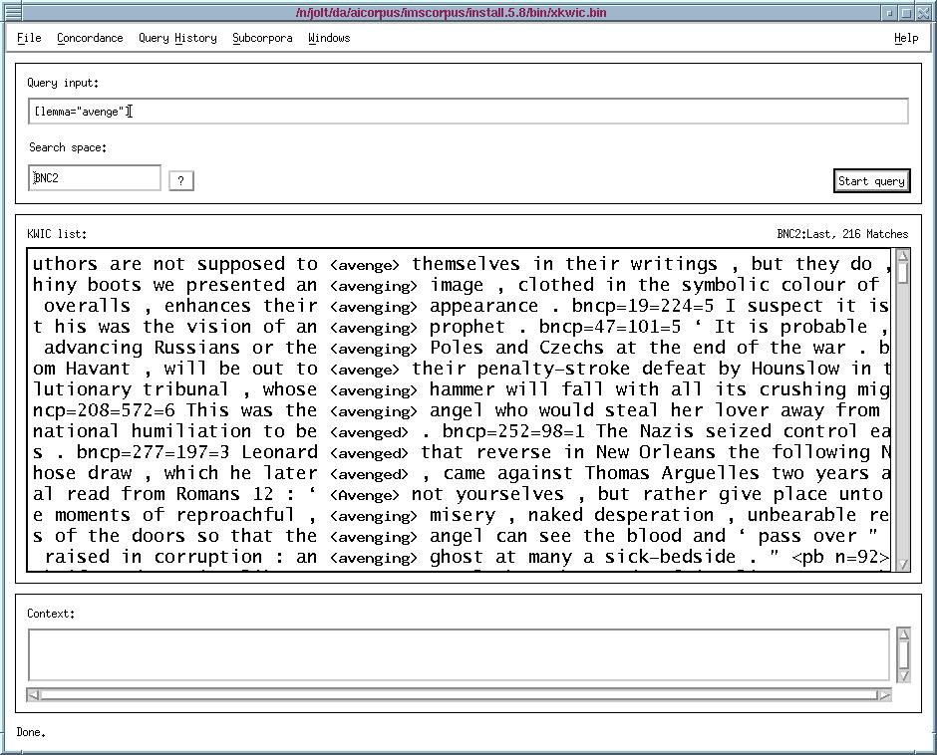

Slide 35
Obviously we need to conduct a more regimented search,
grouping examples with related structures.

Slide 36
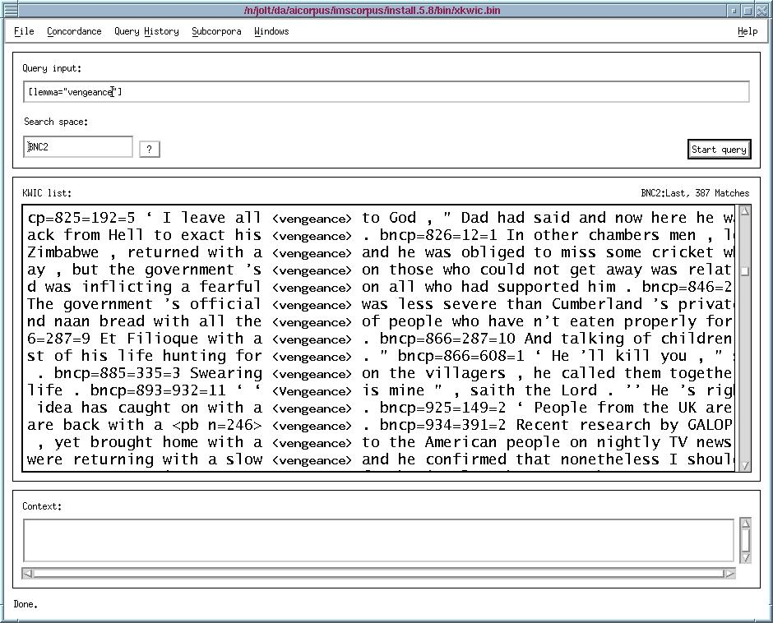

Slide 37
Examples of simple use are swamped by the idiomatic phrase
"with a vengeance".

Slide 38
FN work: annotating examples
We select sentences exhibiting common collocations and showing all major syntactic contexts.
Using the names assigned to FEs in the frame, we label the constituents of sentences that express these FEs.
The next slide shows what our software looks like.

Slide 39
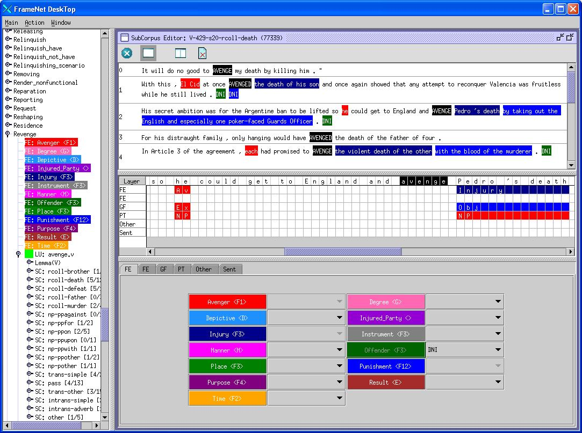

Slide 40
llist of frame names

Slide 41
llist of FEs for Revenge frame

Slide 42
list of contexts chosen for avenge

Slide 43
sentences
with
avenge
and
“death”

Slide 44
annotators’
work
space

Slide 45
core
core
core
core
core

Slide 46
FN work: summarizing results
Automatic processes summarize the results, linking FEs with information about their grammatical realization.
The output is presented in the form of various reports in the public website, in XML format in the data release.

Slide 47
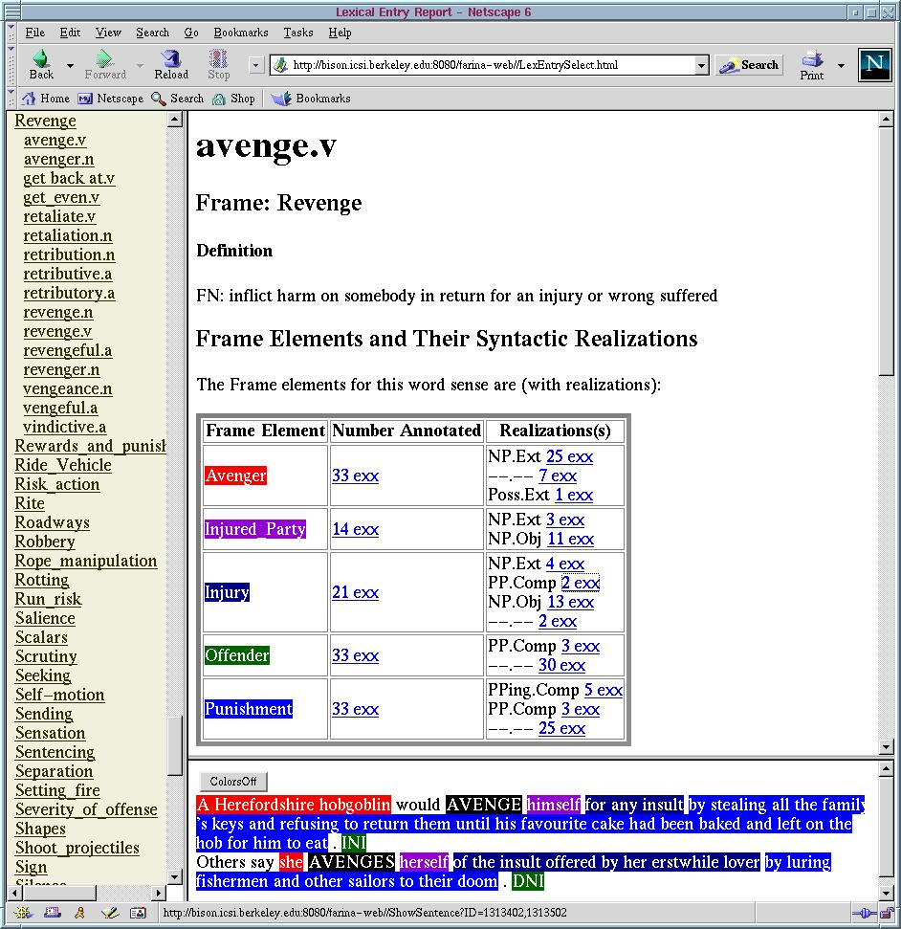

Slide 48
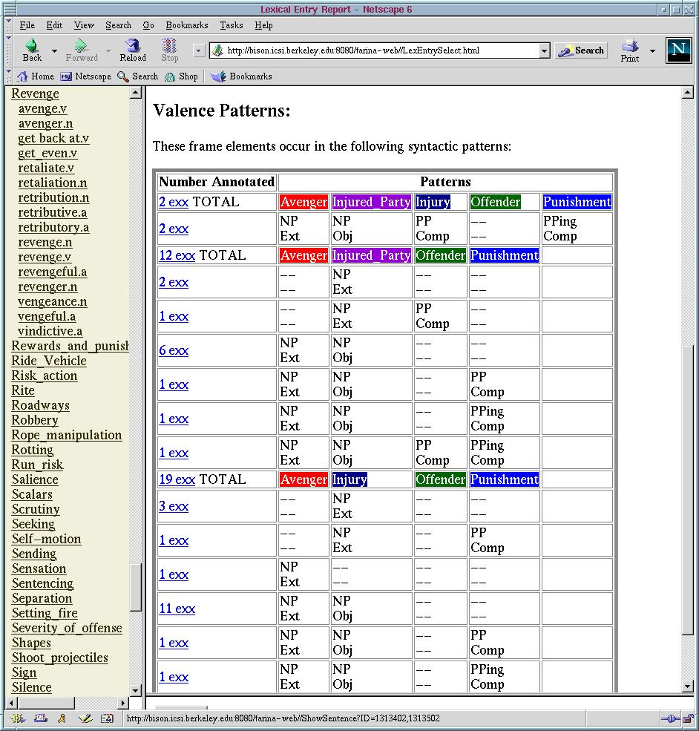

Slide 49
I avenged my brother.

Slide 50
I avenged my brother’s death.

Slide 51
Querying the data: meaning to form
Through various viewers built on the FN database we can, for example, ask how particular FEs get expressed in sentences evoking a given frame.

Slide 52
By what syntactic means is offender realized?
Sometimes as direct object:
  we'll pay you back for that
Sometimes with the preposition on
  they'll take vengeance on you
Sometimes with against
  we'll retaliate against them
Sometimes with with
  she got even with me
Sometimes with at
  they got back at you

Slide 53
By what syntactic means is offender realized?
Sometimes as direct object:
  we'll pay you back for that
Sometimes with the preposition on
  they'll take vengeance on you
Sometimes with against
  we'll retaliate against them
Sometimes with with
  she got even with me
Sometimes with at
  they got back at you
It's these word-by-word
specializations in
FE-marking that make
automatic FE recognition
difficult.

Slide 54
Querying the data: form to meaning
Or, going from the grammar to the meaning, we can choose particular grammatical contexts and ask which FEs get expressed in them.

Slide 55
What FE is expressed by the object of avenge?
Sometimes it's the injured_party
  I've got to avenge my brother
.Sometimes it's the injury
  My life goal is to avenge my brother's murder.

Slide 56
Evaluation
Lexical coverage. We want to get all of the important words associated with each frame.
Combinatorics. We want to get all of the syntactic patterns in which each word functions to express the frame.

Slide 57
Evaluation, cont’d
We do not ourselves collect frequency data. That will wait until methods of automatic tagging get perfected.
In any case, the results will differ according to the type of corpus - financial news, children's literature, technical manuals, etc.

Slide 58
What do we end up with?
Frames
Lexical entries
Annotations

Slide 59
Sample from frames list
Creating, Crime_scenario, Criminal_investigation, Criminal_process, Cure. Custom, Damaging, Dead_or_alive, Death, Deciding, Deny_permission, Departing, Desirability, Desiring, Destroying, Detaining, Differentiation, Difficulty, Dimension, Direction, Dispersal, Documents, Domain, Duplication, Duration, Eclipse, Education_teaching,Emanating, Emitting, Emotion_active, Emotion_directed, Emotion_heat, Employing, Employment, Emptying, Encoding, Endangering, Entering_of_plea, Entity, Escaping, Evading. Evaluation, Evidence, Excreting, Execution,

Slide 60
Sample from lexical unit list
* augmentation.N (Expansion)
* augur.V (Omen)
* August.N (Calendric_unit)
* aunt.N (Kinship)
* auntie.N (Kinship)
* austere.A (Frugality)
* austerity.N (Frugality)
* author.V (Text_creation)
* authoritarian.A (Strictness)
* authorization.N (Documents)
* autobahn.N (Roadways)
* autobiography.N (Text)
* automobile.N (Vehicle)
* autumn.N (Calendric_unit)
* avalanche.N (Quantity)
* avenge.V (Revenge)
* avenger.N (Revenge)
* avenue.N (Roadways)
* aver.V (Statement)

Slide 61
Added Value: frame relatedness
We have ways of linking frames to each other, through relations of
  inheritance
  subframe
  "using"
We would like to explore how our frame relationships can be mapped onto ontological relations.

Slide 62
Frame-to-frame relations
Revenge inherits Punishment/Reward
Revenge uses the Hostile_encounter frame

Slide 63
Added Value: semantic types
We also have the means of adding semantic types to words, frames and frame elements.
Some of these:
  negative vs. positive
  (disaster vs. bonanza),
  punctual vs. stative
  (arrive vs. reside),
  artifact vs. natural kind
  (building vs. tree).

Slide 64
Added Value: support verbs
In the case of the event nouns, we keep track of which verbs can combine with which nouns to signal occurrences of the frame evoked by the noun.
  take a bath (bathe)
  have an argument (argue)
  wreak vengeance,
  take revenge,
  exact retribution.

Slide 65
Comparison with Dictionaries

Slide 66
American Heritage Dictionary
avenge v.
1. To inflict a punishment or penalty in return for; revenge
2. To take vengeance on behalf of
revenge v.
1. To inflict punishment in return for (injury or insult)
2. To seek or take vengeance for (oneself or another person); avenge

Slide 67
American Heritage Dictionary
avenge v.
1. To inflict a punishment or penalty in return for; revenge
2. To take vengeance on behalf of
revenge v.
1. To inflict punishment in return for (injury or insult)
2. To seek or take vengeance for (oneself or another person); avenge
The FEs of the direct objects are expressed prepositionally;
in return for marks the injury; for or on behalf of marks
the injured_party.

Slide 68
American Heritage Dictionary
avenge v.
1. To inflict a punishment or penalty in return for
[ ]; revenge
2. To take vengeance on behalf of [ ]
revenge v.
1. To inflict punishment in return for (injury or insult)
2. To seek or take vengeance for (oneself or another person); avenge
The revenge definer added qualifications on the missing
argument, the avenge definer didn't.

Slide 69
American Heritage Dictionary
avenge v.
1. To inflict a punishment or penalty in return for; revenge
2. To take vengeance on behalf of
revenge v.
1. To inflict punishment in return for (injury or insult)
2. To seek or take vengeance for (oneself or another person); avenge
avenge definer claims avenge and revenge are
synonyms in sense 1; the revenge definer claims avenge
and revenge are synonyms in sense 2.

Slide 70
American Heritage Dictionary
avenge v.
1. To inflict a punishment or penalty in return for; revenge
2. To take vengeance on behalf of
revenge v.
1. To inflict punishment in return for (injury or insult)
2. To seek or take vengeance for (oneself or another person); avenge
Both definers include "take vengeance" in their definitions, as
if that's more transparent than the simple verb.

Slide 71
Comparison with WordNet

Slide 72
We make fewer distinctions.
1. revenge, avenge, retaliate -- (take revenge for a perceived wrong; "He wants to avenge the murder of his brother")
2. retaliate, strike back -- (make a counterattack and return like for like, esp. evil for evil; "The Empire strikes back"; "The Giants struck back and won the opener"; "The Israeli army retaliated for the Hamas bombing")

Slide 73
We make fewer distinctions.
1. revenge, avenge, retaliate -- (take revenge for a perceived wrong; "He wants to avenge the murder of his brother")
2. retaliate, strike back -- (make a counterattack and return like for like, esp. evil for evil; "The Empire strikes back"; "The Giants struck back and won the opener"; "The Israeli army retaliated for the Hamas bombing")
Hard to figure out what motivates distinguishing two senses;
personal vs. institutional?

Slide 74
Does anybody find this useful?
Frame descriptions as event ontology. (Heidelberg)
FrameNet data for language teaching (Sato)
FrameNet annotations for machine learning (SENSEVAL-3 competition)
FrameNet parsing for question-answering (AQUAINT, others)

Slide 75
FrameNets in other languages?
Spanish (Barcelona; Carlos Subirats)
German (Saarbrücken; Manfred Pinkal)
Japanese (Tokyo; Kyoko Ohara)
Swedish (Lund; Ake Viberg)

Slide 76
http://www.icsi.berkeley.edu/~framenet

